Slide 1
Smart Shelves
Group ID – 1435
Christopher Mayes - cmaye001
Jasper Robinson - jrobi001
Marisa Doyne - mdoyn010
Jignesh Devji - jdevj001
Elhassania Ghazoini - eghaz001
Francis Aquino - faqui001

Slide 2
What was the concept and who was it for?
All in one inventory system
Medium sized stock environments
Our goal is to reduce the time and stress associated with inventory management
Eliminate the need for stock checks and the physical updating of stock logs
Notes:
We are proposing an all in one inventory system targeted towards medium sized stock environments. Stock management is often viewed as both essential and an inconvenience, one that keeps people from the other work they want to achieve. Our goal is to reduce the time and stress associated with inventory management by providing stock information instantly to the user on request. This should eliminate the need for stock checks and the physical updating of stock logs.

Slide 3
What was built?
System is generally comprised of a ‘smart-shelf’
Collects stock data
Displayed in a web application
Connected via a database over the internet
Users can set up shelf spaces to keep track of different items
Current stock levels
Threshold warnings
Notes:
Our system is generally comprised of a ‘smart-shelf’ which collects stock data and a web application which displays that information to the stock manager. The shelf and application are connected via a database over the internet.
Users can set up shelf spaces to keep track of different items. The application will display the current stock levels of the items on this shelf space. Warnings will be sent to the inventory manager if any specific item falls below a set threshold, meaning if set up correctly even stock checks within the app need only be done when prompted.
These features combined should hopefully make our system a compelling solution to the inventory needs of medium sized stock environments: preventing stock shortages and taking many of the pressures of inventory management tasks off the manager.

Slide 4
How was it tested?
A quality assurance and control approach was employed throughout the development of the web application
Quality assurance and control during development was initiated by following a Model View Controller approach
creating a model for each table in the database
outlining and storing in the model the database calls and functions required ]
Before creating a route, the database model was consulted and functions and calls were written in those models to achieve the desired outcome
Newly generated functions were then run in test routes with valid data
EJS template was created to check that the route would accept valid inputs and then display the desired information correctly
Invalid inputs were considered, such as shelf values outside of expected ranges, retrieving information from empty shelves and inputting the wrong data type into form fields
final ‘real world’ test was conducted on it by running through functions with valid and invalid input data
Notes:
A quality assurance and control approach was employed throughout the development of the web application, database and Arduino scale shelf components of the Smart Shelf in order to prevent and detect errors early on. This is desirable because it provides greater confidence in the quality of the product components created at each stage.
Quality assurance and control during development was initiated by following a Model View Controller approach. This consisted of creating a model for each table in the database and then outlining and storing in the model the database calls and functions required in the application layer to create, update, read and delete objects in a particular table.
Before creating a route the database model was consulted and the desired outcome considered. After considering what should happen, database calls and functions would be written in the models to achieve those changes. The newly generated functions were then run in test routes with valid data, where the results were checked using console.log output as well as directly in the database in MySQL Workbench. Once the model functions worked as expected for valid data inputs, the rest of the route was built up and tested using console.log and res.send to check that behaviour and output was as expected.
When the requirement for the route logic to function correctly with valid input was satisfied, an EJS template was created to check that the route would accept valid inputs and then display the desired information correctly and without crashing.
Next invalid inputs were considered such as shelf values outside of expected ranges, retrieving information from empty shelves and inputting the wrong data type into form fields. For example, wherever shelf selectors were used or the shelf position was inserted into the URL as a parameter in a GET request, code was added to check the shelf value was in the correct range of 1-6 before a database call was performed. Blank spaces in numerical fields were dealt with by converting the input to a null value.
After a route (or set of routes) was completed, a final ‘real world’ test was conducted on it by running through it a few times with valid input data and then running through it with invalid input data or closing forms at various stages to see if it would break.

Slide 5
What technologies were used and why?
Web Application chosen over desktop application
web application would allow the user to access the site from any computer
web application would ensure the user always had access to the most up-to date version of the software
Node.js to build the site's middleware
asynchronous operation makes it very good at handling IO intensive operations
expansive library of pre-built tools and modules hosted in the 'node package manager’
SQL over NoSQL
Data to be handled was structured
Easier to set up relations
Lead to thinking more carefully about data organisation and features
Notes:
Our stakeholders outlined that the primary way they saw themselves using our system was at a computer when performing inventory management tasks, such as re-ordering items.
Our proposal outlined a plan to create a desktop JAVA application, but over the winter break we changed plans to build an application using Node.js and Express with a MySQL database back end.
A web application was chosen over a JAVA desktop app for several reasons. The two most major being that:
A web application would allow the user to access the site from any computer without the need to install the application, increasing convenience.
A web application would ensure the user always had access to the most up-to date version of the software, which falls more in line with modern user expectations of software to be provided as a service, continually being updated and improved.
We selected Node.js to build the site's middleware partly because Node's asynchronous operation makes it very good at handling IO intensive operations.
We knew the server may have to handle both the load of requests from users as well as the flow of data from shelves as they periodically sent updated weight information to be inserted into the database, so a framework capable of handling a lot of requests was essential.
Node's was also attractive because it has an expansive library of pre-built tools and modules hosted in the 'node package manager'. The 'Express' and the 'MySQL' node modules vastly simplified the processes of handling requests and interacting with the database, saving a lot development time.
A relational SQL database system was chosen over noSQL systems such as MongoDB as we knew the weight, shelf and item data being handled would all be structured.
Relations can be created in NoSQL databases, but are slower and more difficult to set up.
We also felt that a structured model with defined tables would force us to think carefully about the data organisation needed accommodate all planned features from the start. Rigidly planning the data structure before hand reduced the likelihood of discovering we needed to drastically re-organise the way we stored data down the line.

Slide 6
Challenges and solutions to them
Frequency of meeting
Meeting with available members
Online Meetings
Learning how to build a web application while doing so
Each member learning different techniques from different sources
Some code became hard to follow for others
More meetings to discuss code
Managing the Trello and backlog
Often forgotten amongst the weekly tasks we set for ourselves
Sometimes relied on messaging to be allocated available tasks
More frequent meetings even if not all could attend
Greater responsibility on scrum leader for admin tasks rather than development tasks
Notes:
It was generally felt that face to face meetings were better and we strived to find times when all members would be available. On reflection it would have been better to either have more frequent meetings with any members who could attend that day or to embrace online meetings via Microsoft teams or some other conferencing software.
There was little getting around the difficulties of learning how to build a web application at the same time as doing so. Each member learnt from different sources and so ended up utilising different techniques writing their code. An example being the two methods of calling the database used in the routing logic. One method uses calls defined in models that generate promises (using the sql2 package) and the other uses database calls embedded directly in routes using callbacks (using the sql package). Both methods were facilitated and worked fine separately and in combination, however the style and structure of the promise code was unfamiliar and hard to follow for some. This made it difficult for members to adapt and extend existing code. This was eventually clarified, but explaining code should have been given greater precedence at team meetings and perhaps been brought up as a repeated point of discussion at the beginning of each meeting.
Managing the Trello board and backlog was an essential, but sometimes forgotten task. At a couple of points in development the backlog was somewhat neglected and members messaged the group asking what they can work on. This worked fine, but may have left those not confident enough to ask unsure of what they could do and also opened up the possibility of two people taking on the same task. The solution to this problem is the same as others, to hold more frequent meetings even if all members could not attend, this would have gone some of the way to keeping everyone updated. Alternatively or in combination the scrum leader could have been given a greater responsibility for managing the backlog and other administrative tasks with in turn less development responsibility.

Slide 7
User Guide

Slide 8
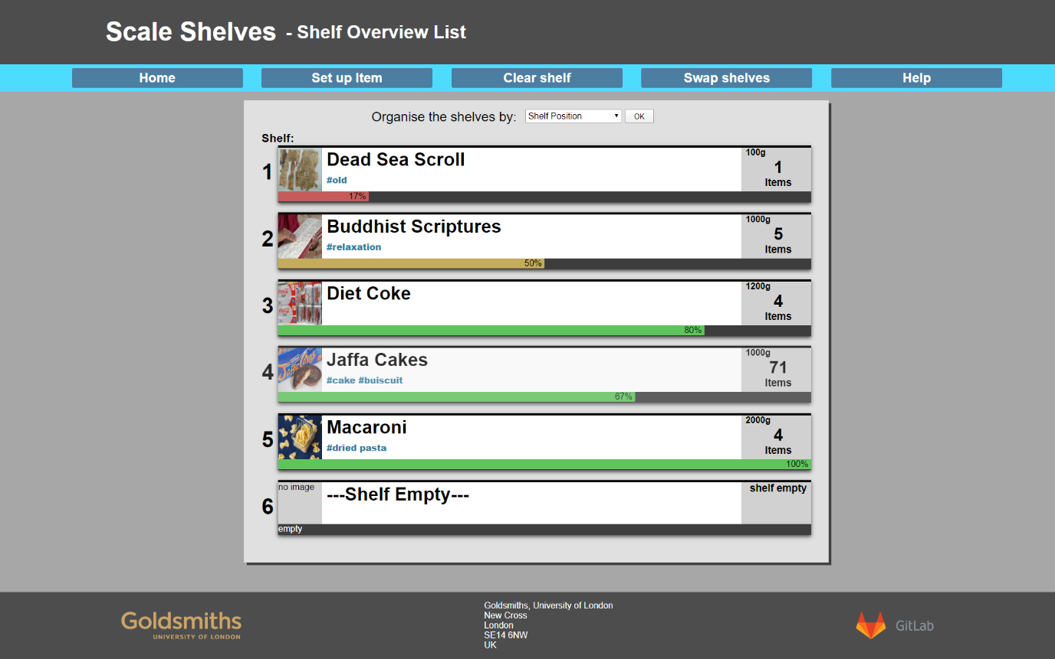
Home page
A list of the shelves and their contents are presented
This includes the shelf number, name of item, weight, number of that item on shelf and tags related to the item
Shelves can be sorted by shelf position, percentage weight, number of items left or absolute weight
Notes:
The user is immediately displayed the home page upon entering the web app. From here, a list of the shelves and their contents are presented. This includes the shelf number, name of item, weight, number of that item on shelf and tags related to the item. The shelves can also be sorted by shelf position, percentage weight, number of items left or absolute weight via the dropdown at the top of the page.

Slide 9
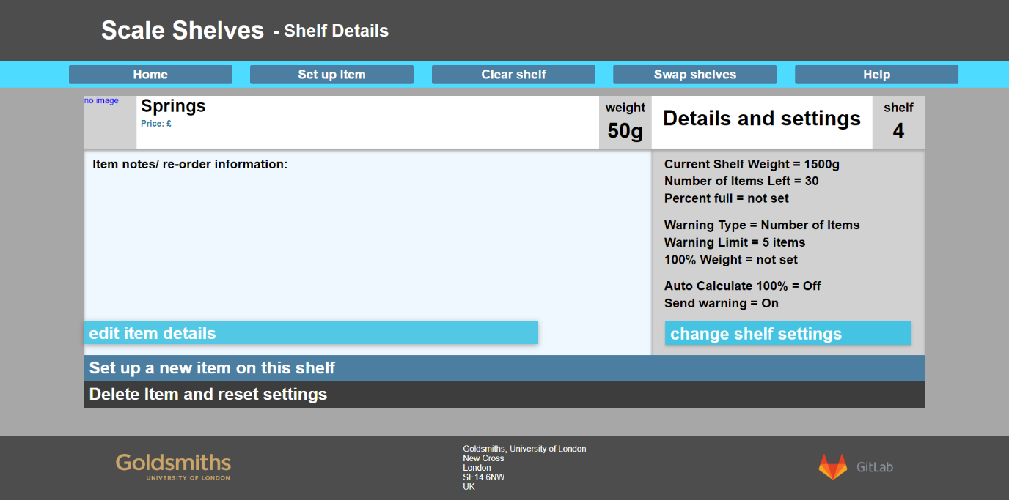
Clicking on a shelf
Table containing a more detailed overview of the elements and settings is displayed
notes and re-order information appears on the left
weight and warning limits on the right
user can edit the item details or change the shelf settings
set up a new item on the shelf or delete and reset the shelf position
Notes:
Upon clicking on a shelf, a table containing a more detailed overview of the elements and settings is displayed. The items notes and re-order information appears on the left and the details regarding weight and warning limits on the right. From this page, the user can edit the item details or change the shelf settings. They also have the option to set up a new item on the shelf or delete and reset the shelf position

Slide 10
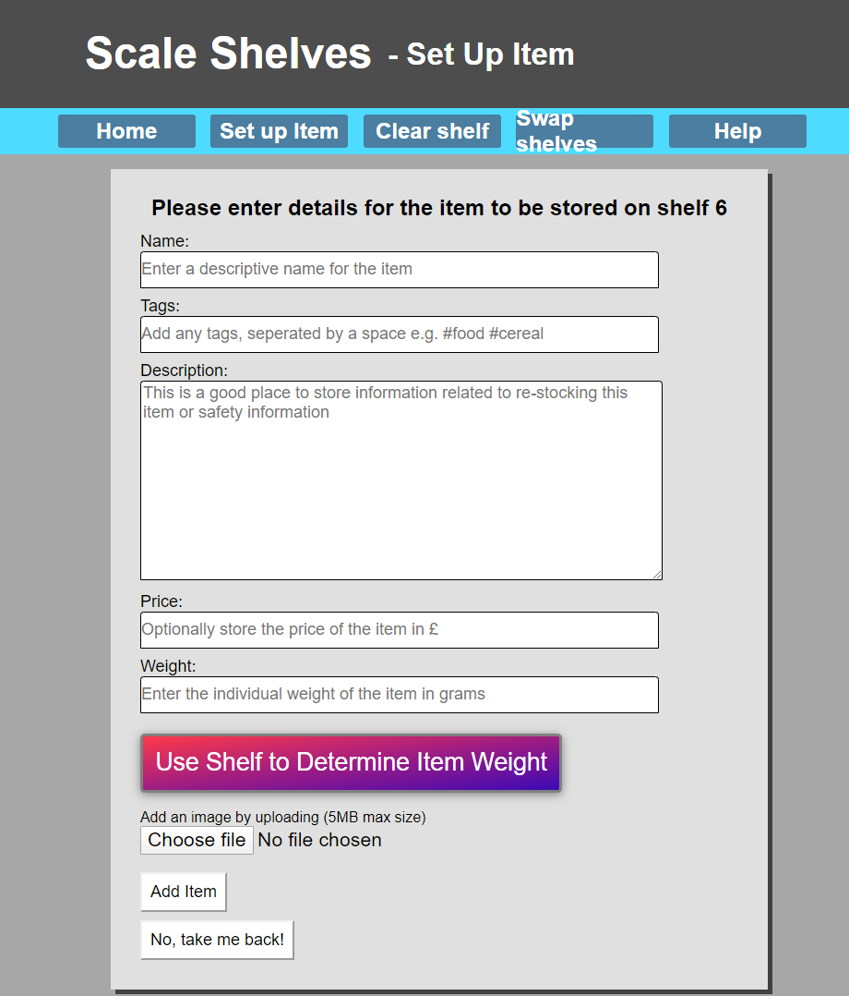
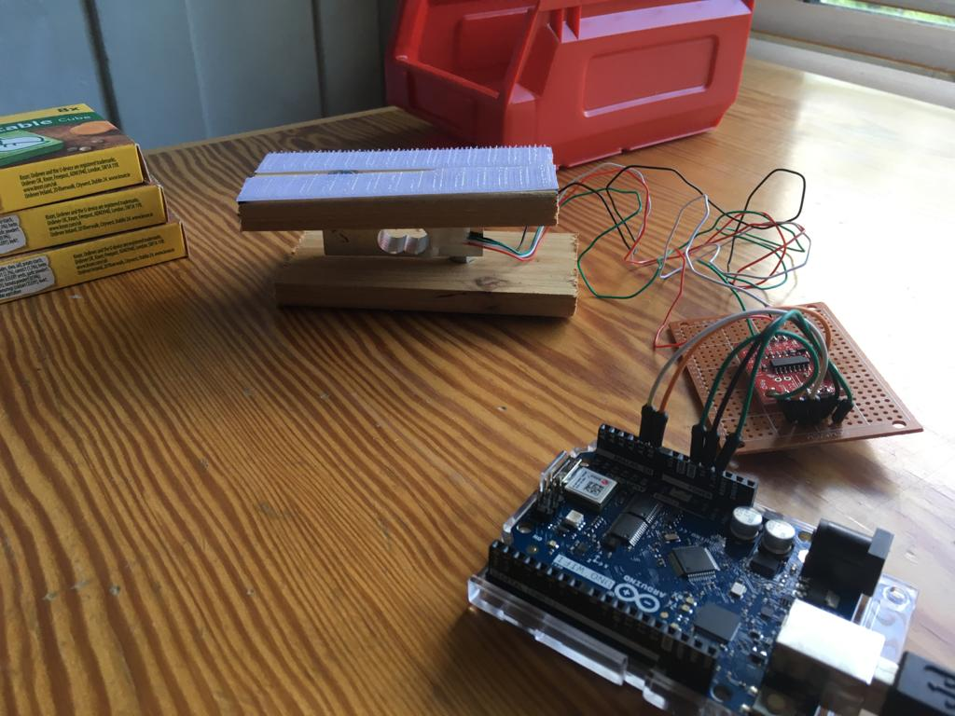
Set Up Item
presents a list of the shelves with their current item if it contains one, or ‘empty’ if not
shelf to set up can be selected and a form will be displayed upon clicking submit
If a shelf with an item on is selected, the user will be notified and asked if they either want to replace the item or go back to the selection screen
set-up form contains a field for the item name, tags, description, price and weight
Any information regarding restocking or safety can be written in the description
The items weight can be set automatically by inputting the individual item weight, or the scales built into the shelf can be used if the weight is unknown
An image for the item can also be added at this stage which will be displayed in the list
Notes:
Selecting the ‘set up item’ from the navigation bar at the top of the screen presents a list of the shelves with their current item if it contains one, or ‘empty’ if not. The shelf to set up can be selected and a form will be displayed upon clicking submit. If a shelf with an item on is selected, the user will be notified and asked if they either want to replace the item or go back to the selection screen. The set-up form contains a field for the item name, tags, description, price and weight. Any information regarding restocking or safety can be written in the description to be easily viewed after the item has been added. The items weight can be set automatically by inputting the individual item weight, or the scales built into the shelf can be used if the weight is unknown. After selecting this option, the item will need to be placed on the shelf and confirmed within the webapp. An image for the item can also be added at this stage which will be displayed in the list

Slide 11
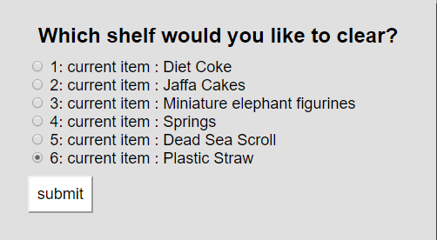
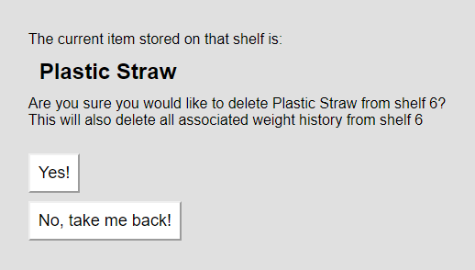
Clearing a shelf
user can delete the data stored on one of the shelf spaces
form containing the shelf numbers as well as items stored is displayed
Upon submitting, a confirmation screen will appear
After selecting ‘yes’ it will be cleared from the database
Notes:
The ‘clear shelf’ page can be selected using the navigation bar at the top of the screen. From here, the user can delete the data stored on one of the shelf spaces. A form containing the shelf numbers as well as items stored is displayed, and after selecting the shelf and clicking submit, a confirmation screen will appear. After selecting ‘yes’ it will be cleared from the database and the space can then be set up to contain a new item if required

Slide 12
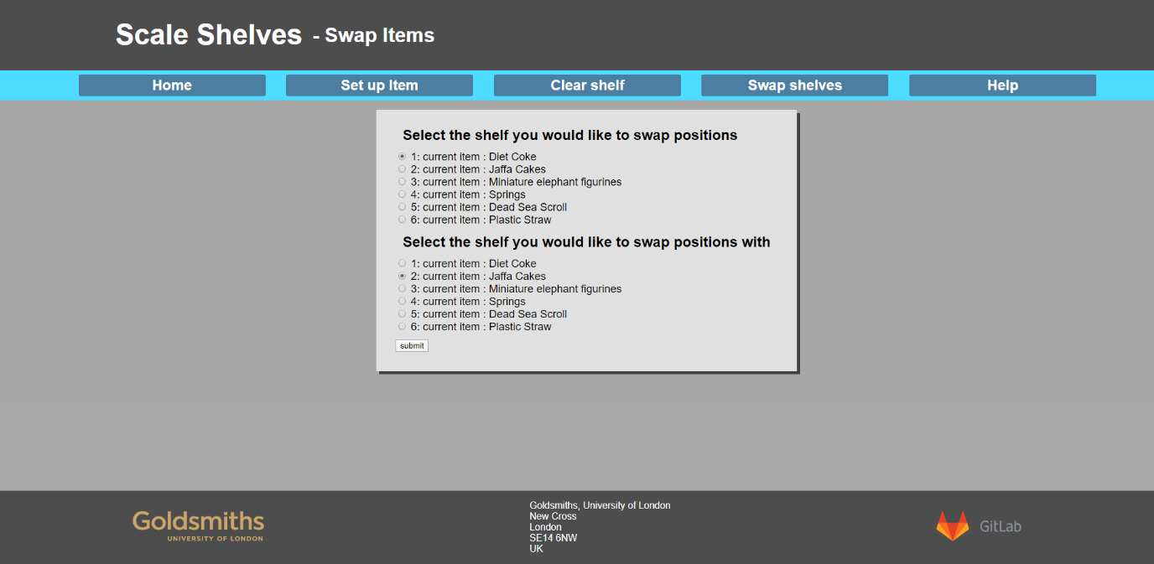
Swapping Shelves
Allows two shelves to have their positions swapped
This includes all data related to those items
Select the shelf you would like to change positions and the shelf that you would like to swap it with and click submit
Notes:
The ‘swap shelves’ page allows two shelves to have their positions swapped. This includes all data related to those items. Select the shelf you would like to change positions and the shelf that you would like to swap it with and click submit. Upon submitting, the shelves will be swapped, and the changes can be viewed in the list on the home page

